Slide 1
Fairness in IIJA Funding
Taha Ahmad

Slide 2
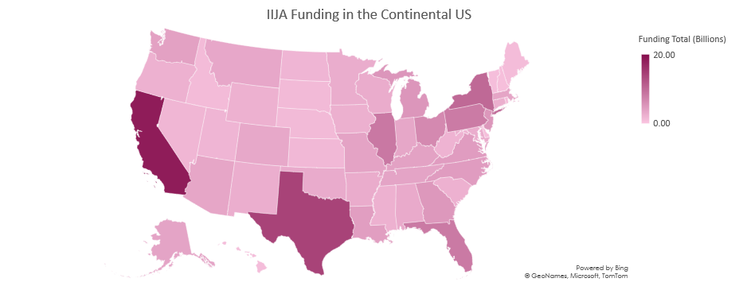
Is Funding Following a Pattern?

Slide 3
Biden Voters?

Slide 4
Region Population?

